Slide 1

QCML Course Lab Session – 08
By Aniket,
Indian Institute of Technology Delhi

Slide 2
What we did last time…
Project List Announcement
Quantum Fourier Transform (Part – 1)

Slide 3
What we will do today…
Project List - FAQs
Quantum Fourier Transform (Part – 2)
Let’s clear our doubts

Slide 4
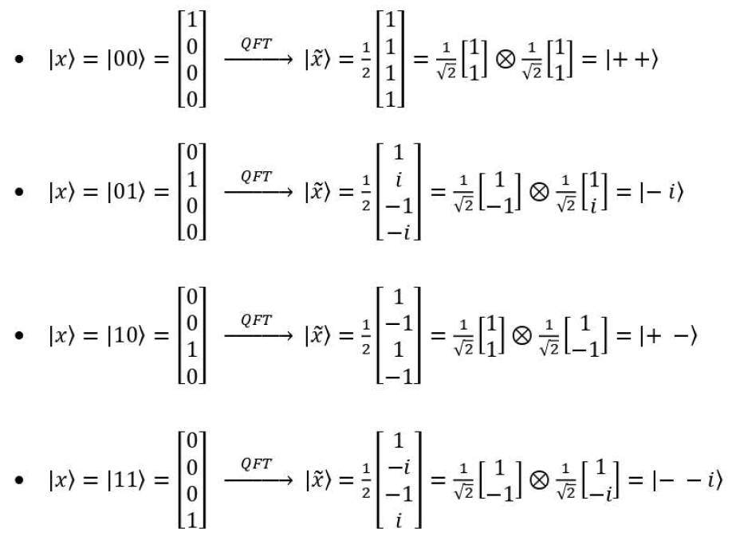
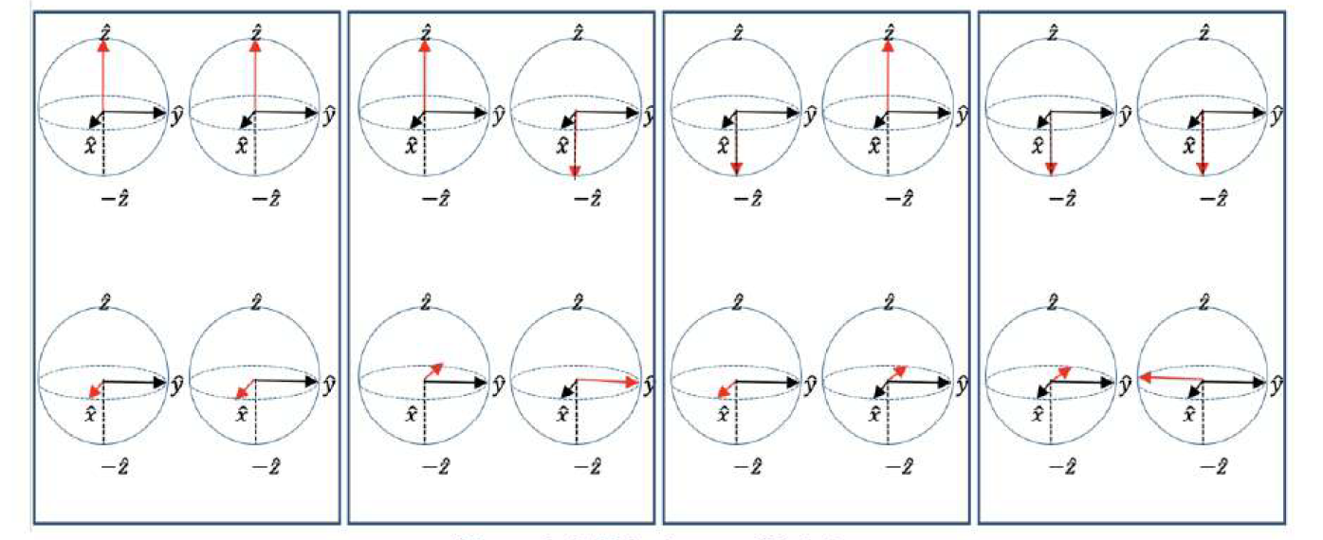

Slide 5
Z - Basis
F - Basis

Slide 6
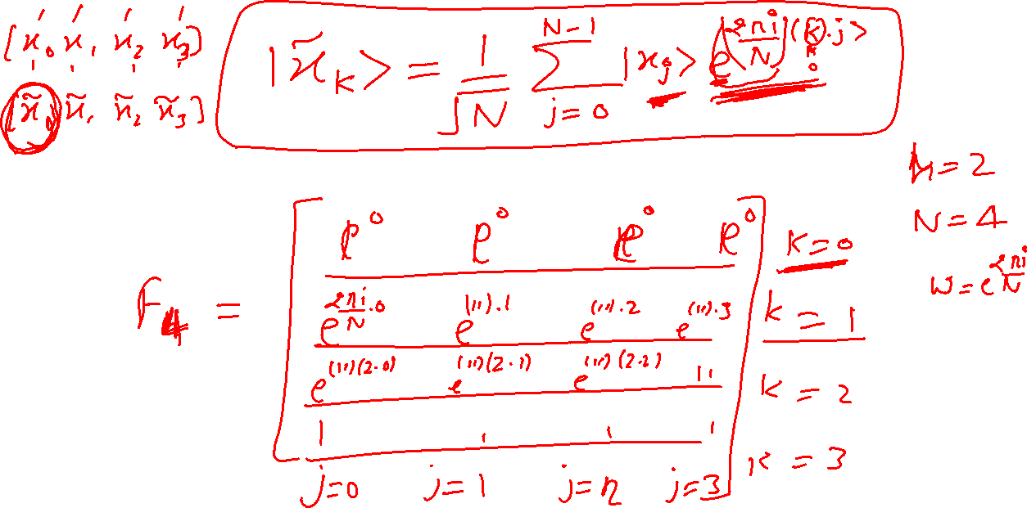

Slide 7
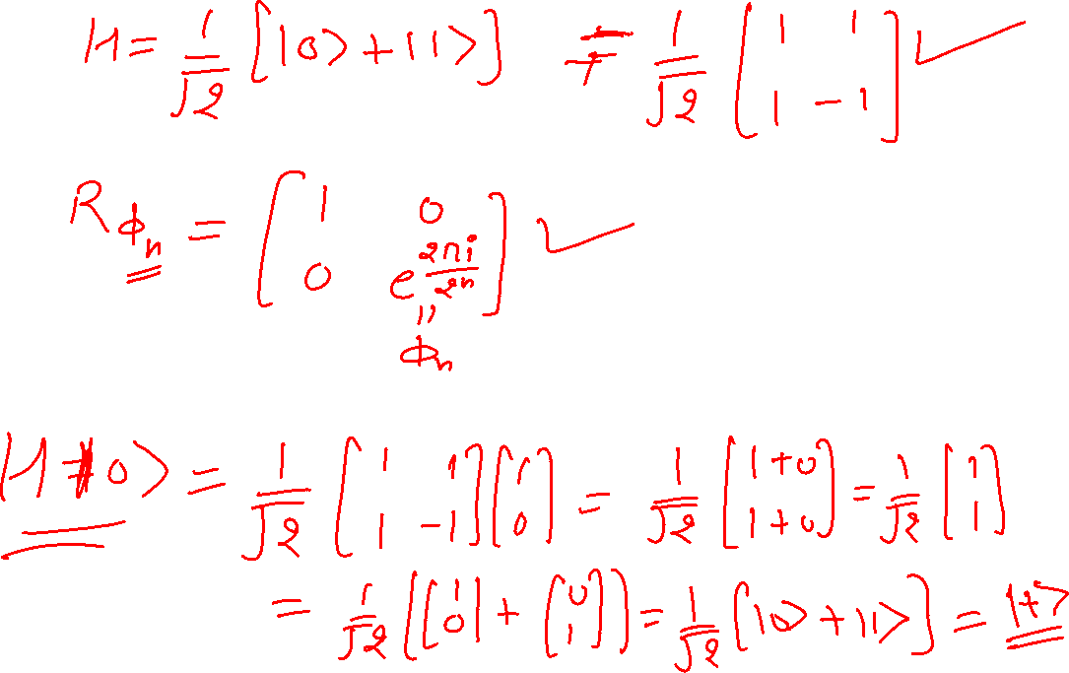

Slide 8
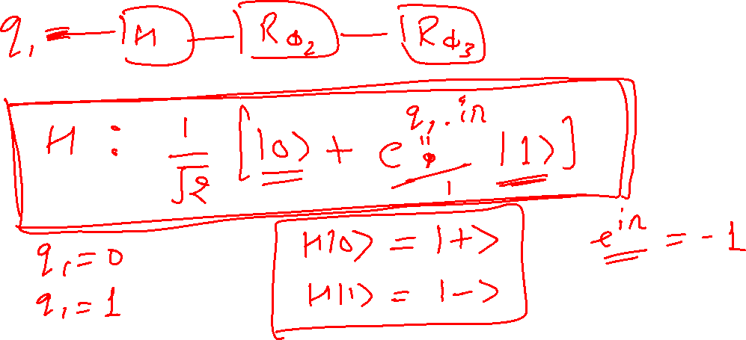

Slide 9
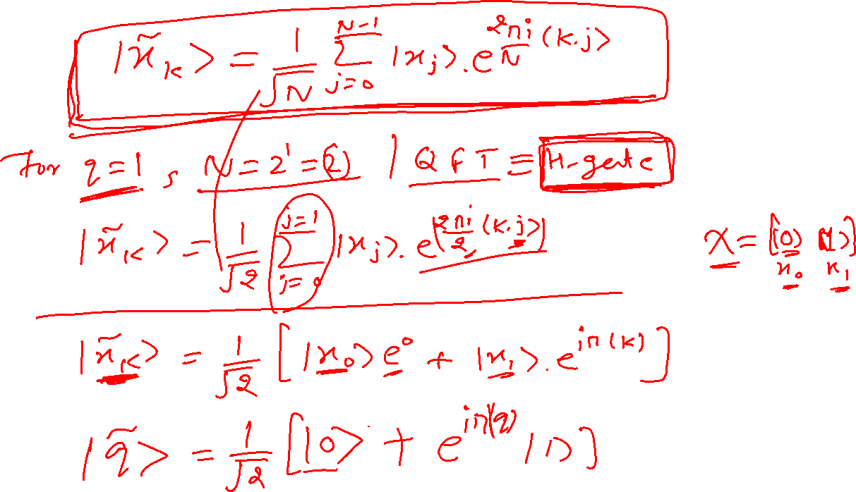

Slide 10
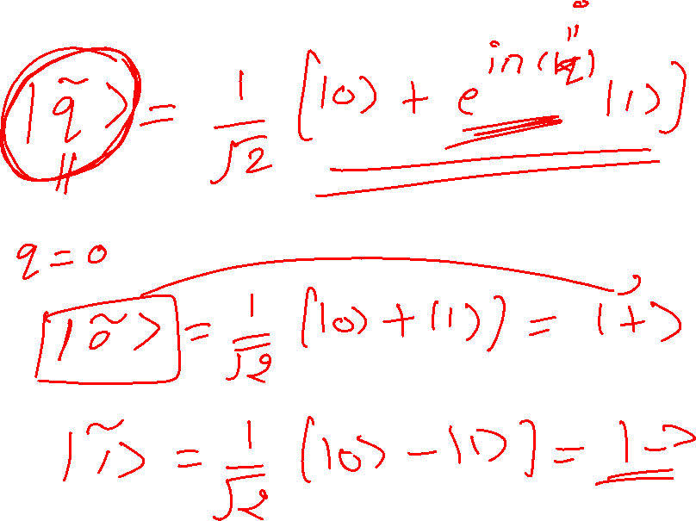

Slide 11
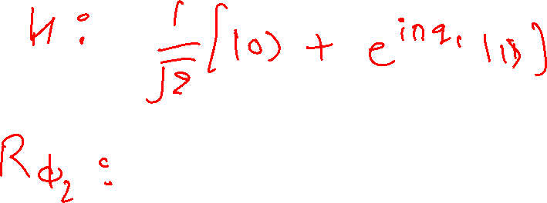
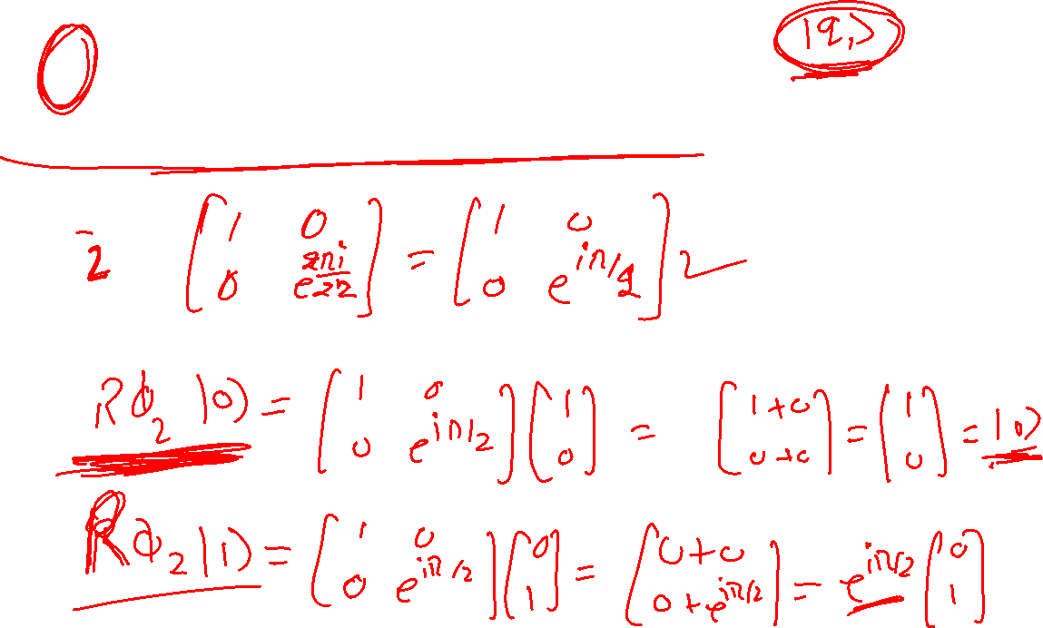

Slide 12
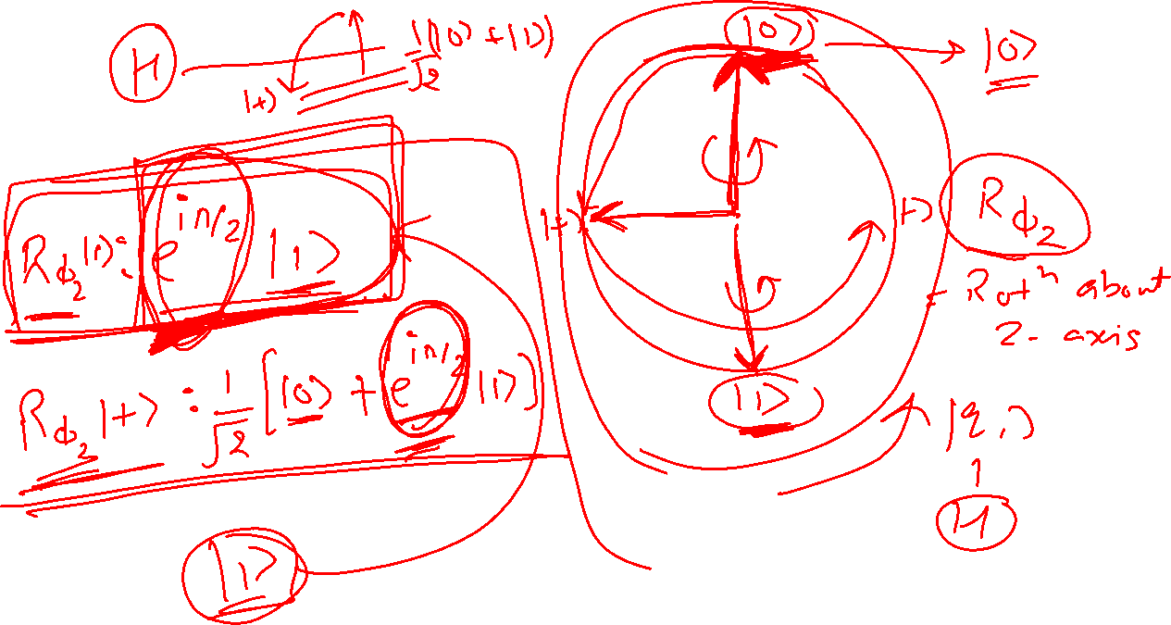

Slide 13
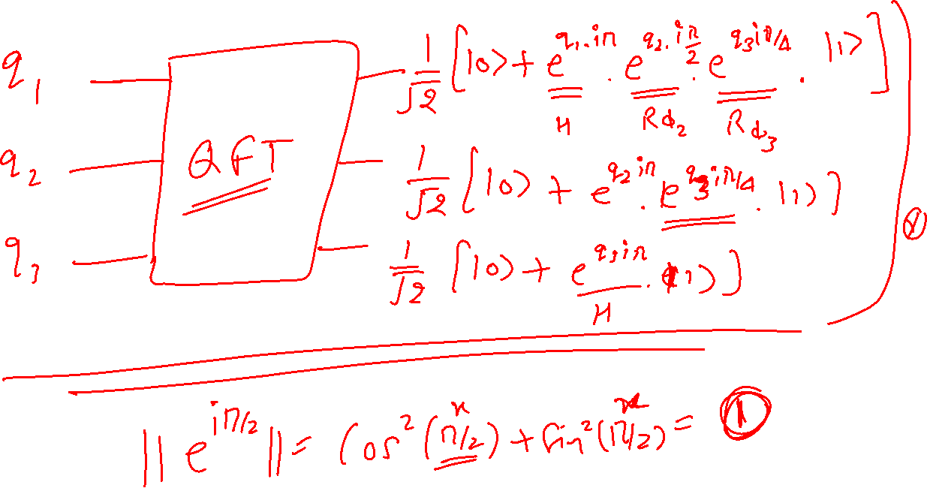

Slide 14
